Slide 1
Rearranging to solve linear equations
Task A: Representing equations with unknowns on both sides
1) Build an equation with unknowns on both sides.
Starting with this balance showing 2x = 8 show what you need to add to both sides to make the equation 7x + 2 = 5x + 10
2x | = | 8
2x + (5x) | = | 8 + (5x)
7x | = | 5x + 8
7x + (2) | = | 5x + 8 + (2)
7x + 2 | = | 5x + 10
2) ‘Un-do’ this balance model to solve this equation.
6x + 4 | = | 3x + 10
6x + 4 + (−3x) | = | 3x + 4 + (−3x)
3x + 4 | = | 10
3x + 4 + (−4) | = | 10 + (−4)
3x | = | 6
x | = | 2
3) Use this bar model to solve this equation.
Write your algebraic notation alongside.
x
x
161
2x + 161 | = | 8x + 29
x
x
x
x
x
x
x
x
29
161 | = | 6x + 29
161
132 | = | 6x
x
x
x
x
x
x
29
x | = | 22
132

Slide 2
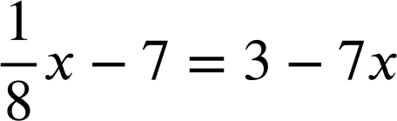
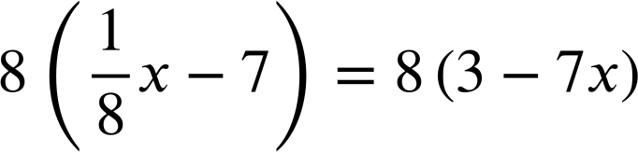
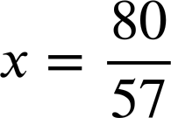
Rearranging to solve linear equations
Task B: Solving equations with unknowns on both sides
1) Solve this equation in two different ways:
3x + 2 | = | 7x − 10
3x + 2 + (10) | = | 7x − 10 + (10)
3x + 12 | = | 7x
3x + 12 + (−3x) | = | 7x + (−3x)
12 | = | 4x
x | = | 3
3x + 2 | = | 7x − 10
3x + 2 + (−3x) | = | 7x − 10 + (−3x)
2 | = | 4x − 10
2 + (10) | = | 4x − 10 + (10)
12 | = | 4x
x | = | 3
a)
b)
2x + 2 | = | 23 − 5x
2x + 2 + (−2) | = | 23 − 5x + (−2)
2x | = | 21 − 5x
2x + (5x) | = | 21 − 5x + (5x)
7x | = | 21
x | = | 3
2x + 2 | = | 23 − 5x
2x + 2 + (5x) | = | 23 − 5x + (5x)
7x + 2 | = | 23
7x + 2 + (−2) | = | 23 + (−2)
7x | = | 21
x | = | 3
2) Find the perimeter of this rectangle.
17 − 2x | = | 3x + 2
17 | = | 5x + 2
15 | = | 5x
x | = | 3
17 − 2x
7
3x + 2
Perimeter = 2(11 + 7) = 2(18) = 36
3) Solve:
x − 56 | = | 24 − 56x
57x − 56 | = | 24
57x | = | 80
Mathematics in Education and Industry.
v2.2

